Slide 1
Linguistic Landscapes
LLED 565: Land Based Literacies
Veronica Maclean
June 16, 2022
Drs. Melanie Wong & Iris Berger

Slide 2
Linguistic landscapes
Investigating “publicly visible bits of written language” with/in the landscape of Kp’ itl’ els /Brilliant (Blommaert & Maly, 2016).

Slide 3
Notes:
By language I mean, the traces, remnants and cultural artifacts that continue to haunt this place. A stone cross, mounds of earth, camas flowers, broom, fruit trees, concrete, & steel.
In the 5 years I have lived in this community I have enjoyed being in the place.

Slide 4
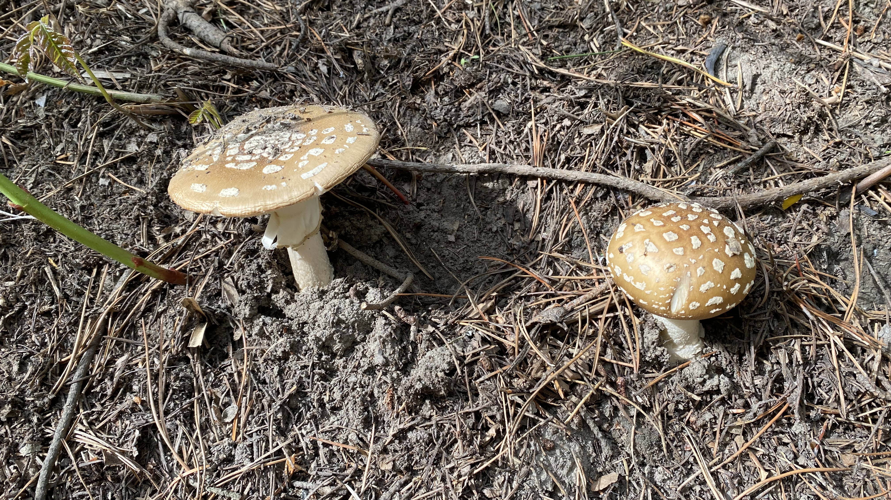
Notes:
For me, the idea of Linguistic Landscapes, requires me to look deeper
To attune to the words, language and stories lingering here.

Slide 5
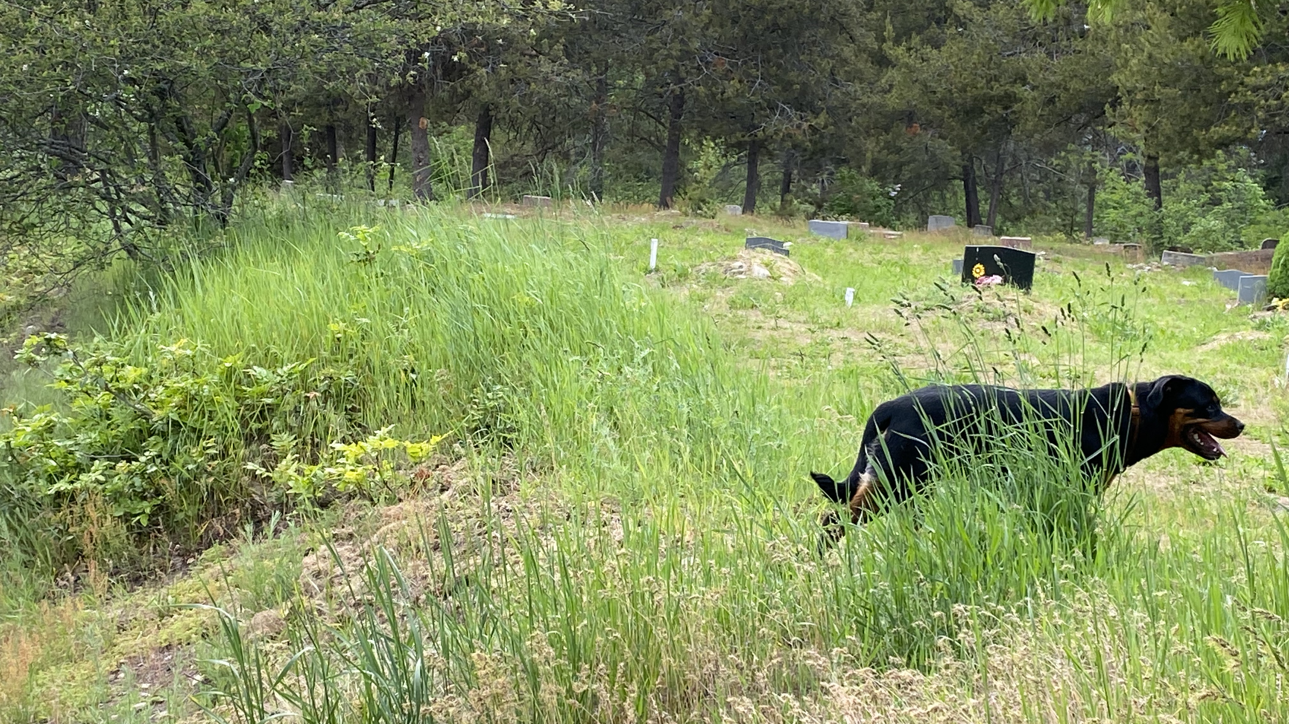
Notes:
This spring Kp ‘itl’ els/ Brilliant Flats has become a favorite spot to take Ruby the Rottweiller as
motorized vehicles have recently been prohibited,

Slide 6
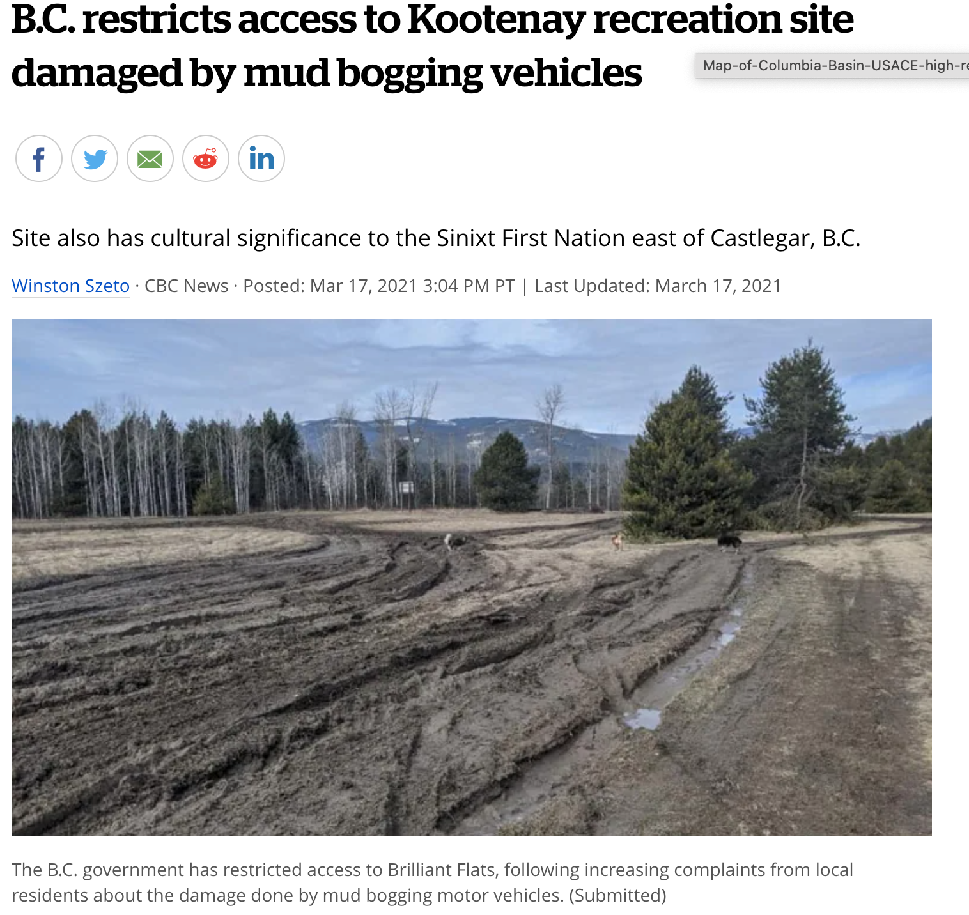
Notes:
“After years of allowing mudbogging I am curious about what instigated this restriction?

Slide 7
Kp’itl’els/Brilliant Flats
“No cultural expression is ever entirely erased within the landscape of memory – perhaps only our ability to recognize its marks upon the land remains obscured” (Wilkinson & Duff, 2012, p. 51)
Notes:
Local scholar’s Wilkinson and Duff write that “No cultural expression is ever entirely erased within the landscape of memory – perhaps only our ability to recognize its marks upon the land remains obscured. And this would certainly be true of Kp’itl’els.

Slide 8
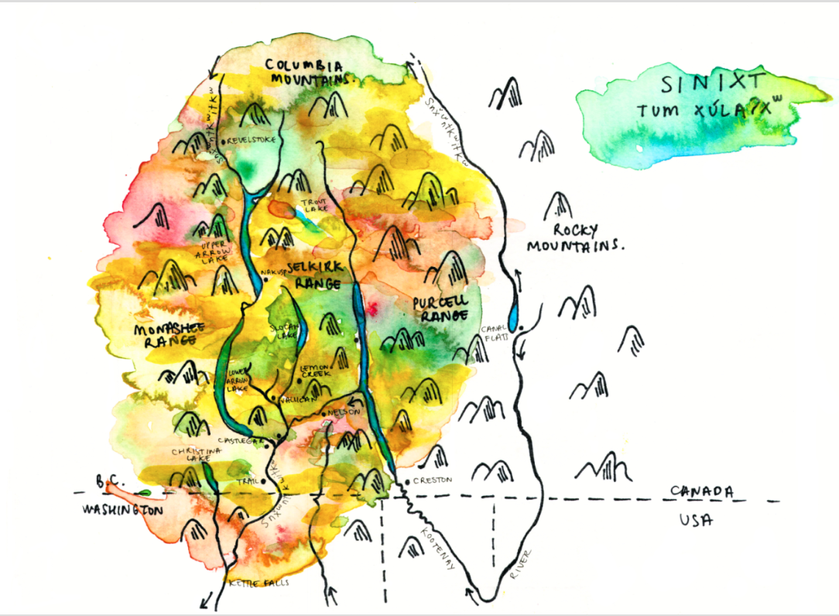
Notes:
This land is part of the Unceded and ancestorial Tum Xu’la (Homeland) of the Sinixt People also known as the Lakes or Arrow Lakes Indians.
In 1956, the Canadian government declared the Sinixt extinct.

Slide 9
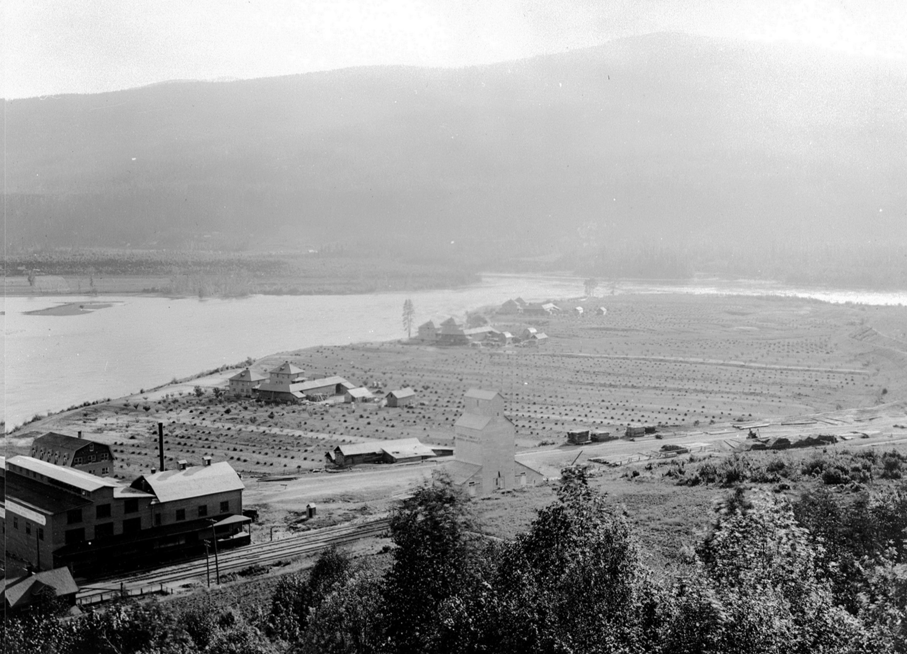
Brilliant, circa 1924
BC Archives Image A-08913. Courtesy of Royal British Columbia Museum, BC Archives. Retrieved from Wilkison & Duff, 2012, p. 37.
Notes:
In the early 20th century this place was also the site of the Doukhobor settlement, Brilliant -- its marks upon the land are less obscured. However this is a story of a people that fled Russia due to persecution for their refusal to bear arms.

Slide 10
Notes:
They were seeking a simple life, but eventually the heavy hand of the government would land here too.

Slide 11
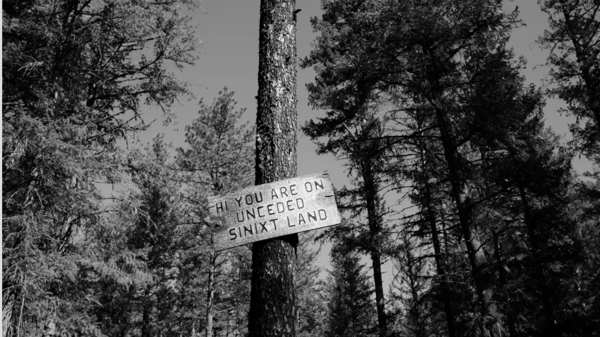
Notes:
How do I embody respect to the multiplicity of voices, memories and devastation, co-exiting in this place? What is my responsibility to and within this place? To the People, Land and more than human other?

Slide 12
Entangled landscapes
Popova (2019) write
“when we try to pick out anything by itself, we find it hitched to everything else in the universe” (John Muir, 1883-1914).
Notes:
“when we try to pick out anything by itself, we find it hitched to everything else in the universe” (John Muir, 1883-1914).
This idea rings true for me as I engage with this place, and with the multiple stories that are entangled within the landscape.

Slide 13
Notes:
During one of our walks we ‘discovered’ a stone monument, curious about the story of this monument, I snapped a picture with my phone to return to later.
I am often taking photos of places, plaques, artifacts and vistas. And I wonder now about the meaning and implications of taking a photo or capturing an image.

Slide 14
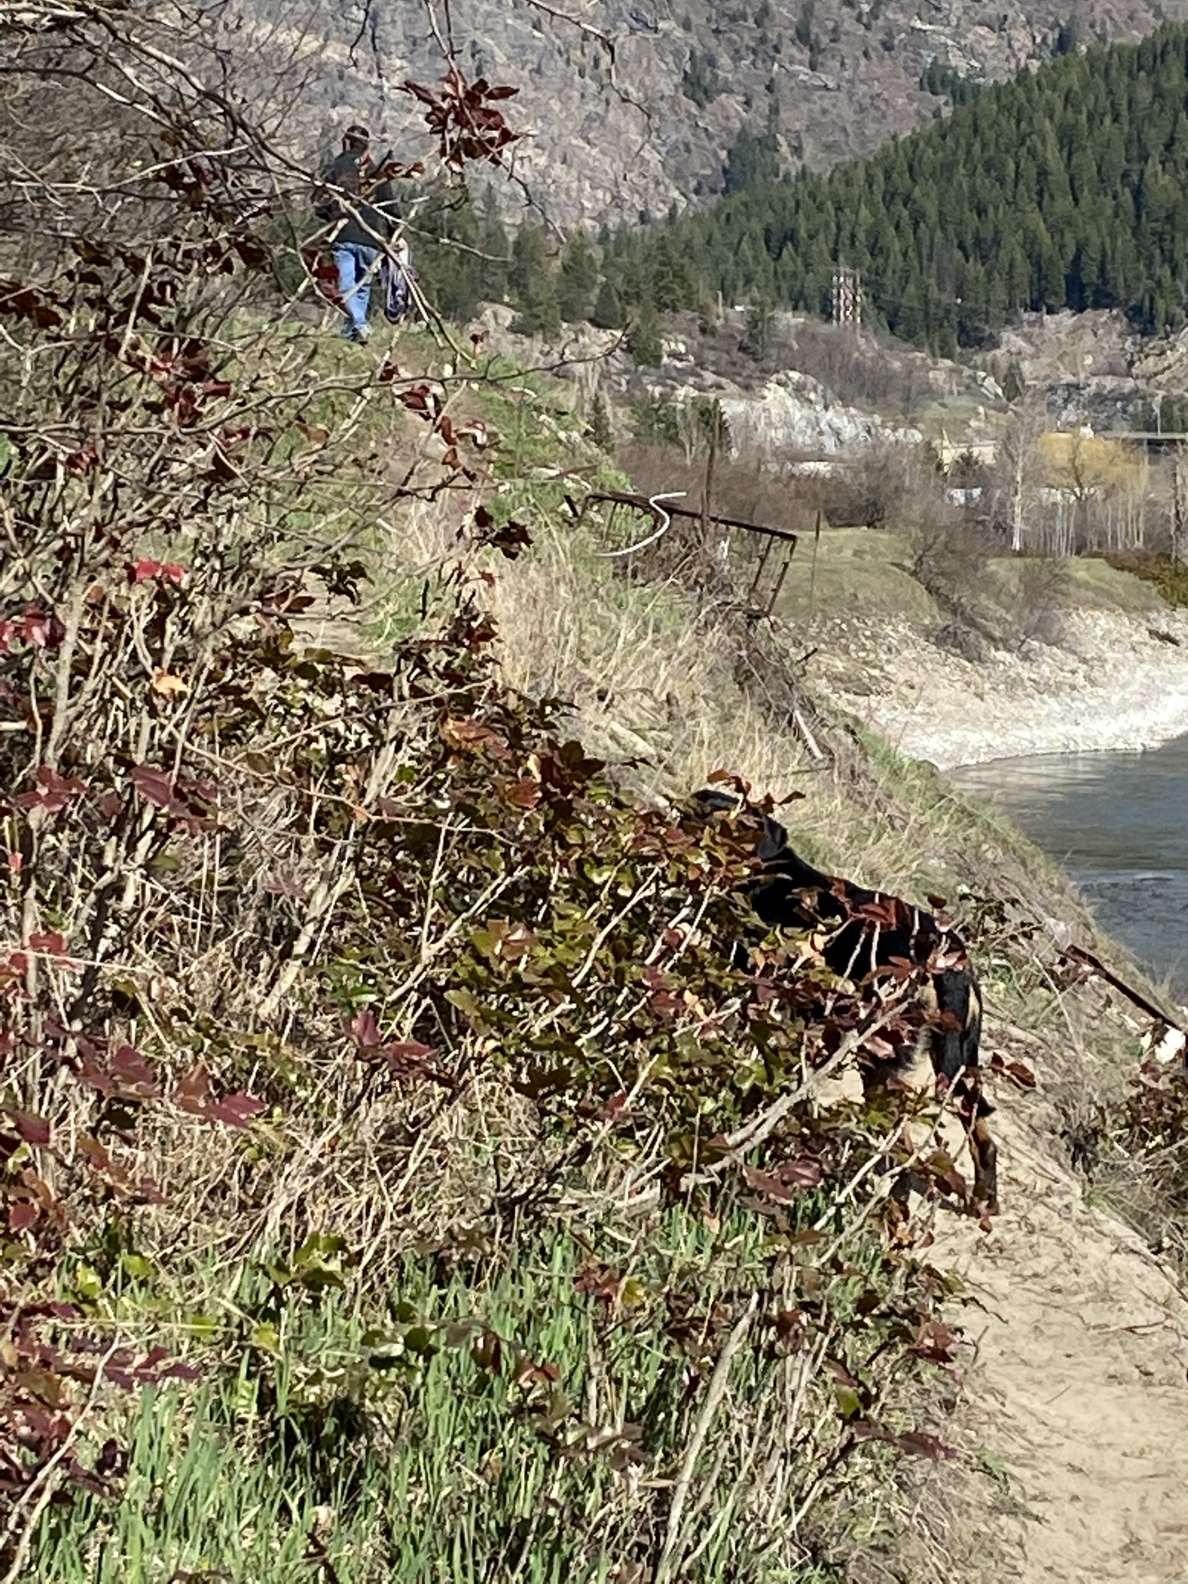
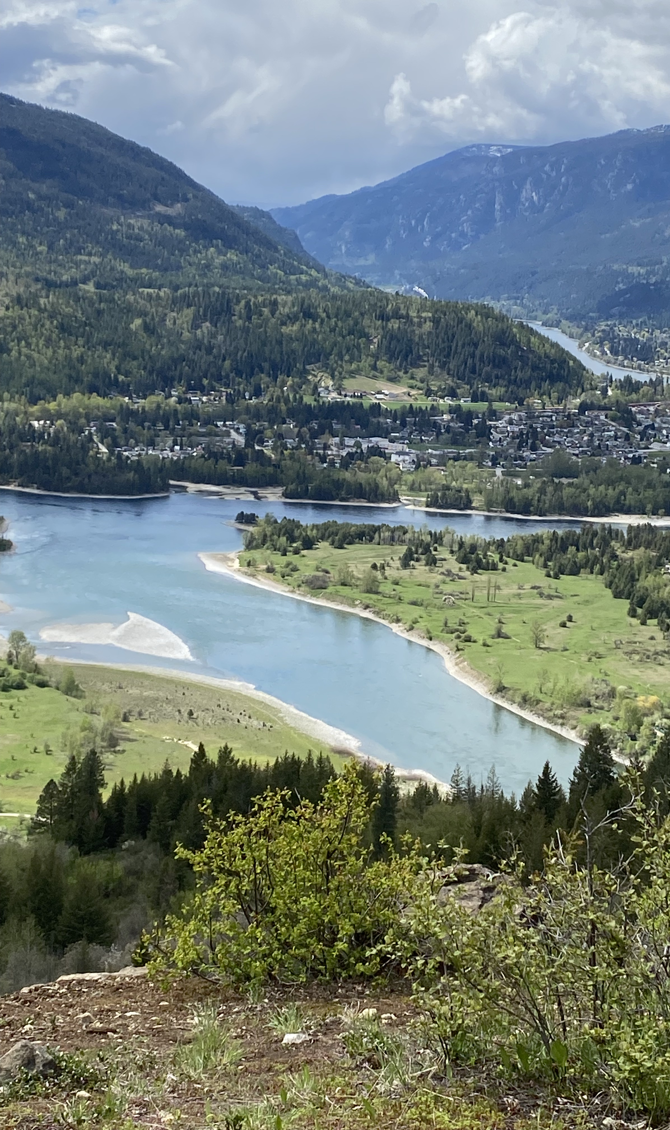
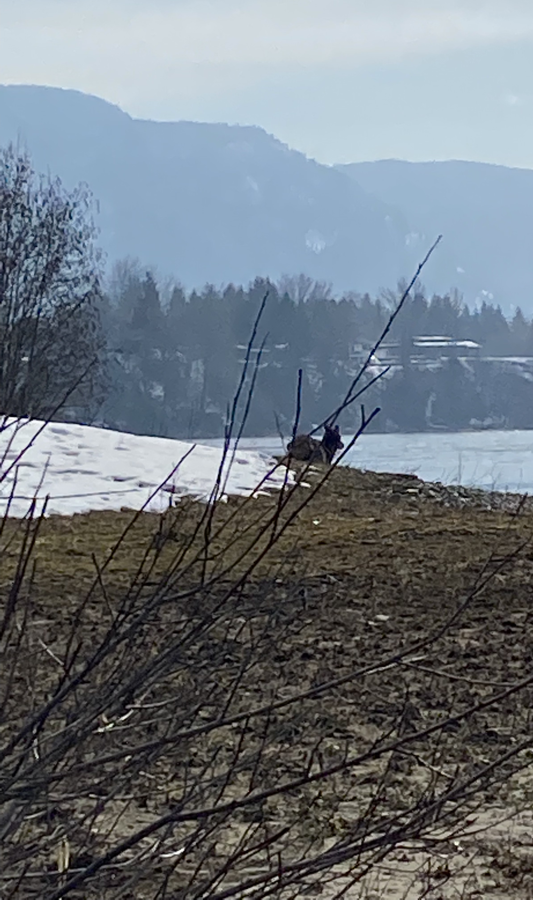
“The land remains remarkably beautiful to this day and largely untouched by human development, except for vestiges of Doukhobor communal orchards and abandoned brick and stone foundations…
A great deal of history is written in the ground”
(Wilkinson & Duff, 2012, p. 54).
Notes:
Wilkinson & Duff write that “The land remains remarkably beautiful to this day and largely untouched by human development, except for vestiges of Doukhobor communal orchards and abandoned brick and stone foundations. They write that a great deal of history is written in the ground”.

Slide 15
Notes:
I wonder how about the statement that the land remains largely untouched, as it was completely transformed by the Doukhobors.
I do agree with their statement that ‘a great deal of history is written in the ground’ and I would add that the land eventually reveals her secrets.

Slide 16
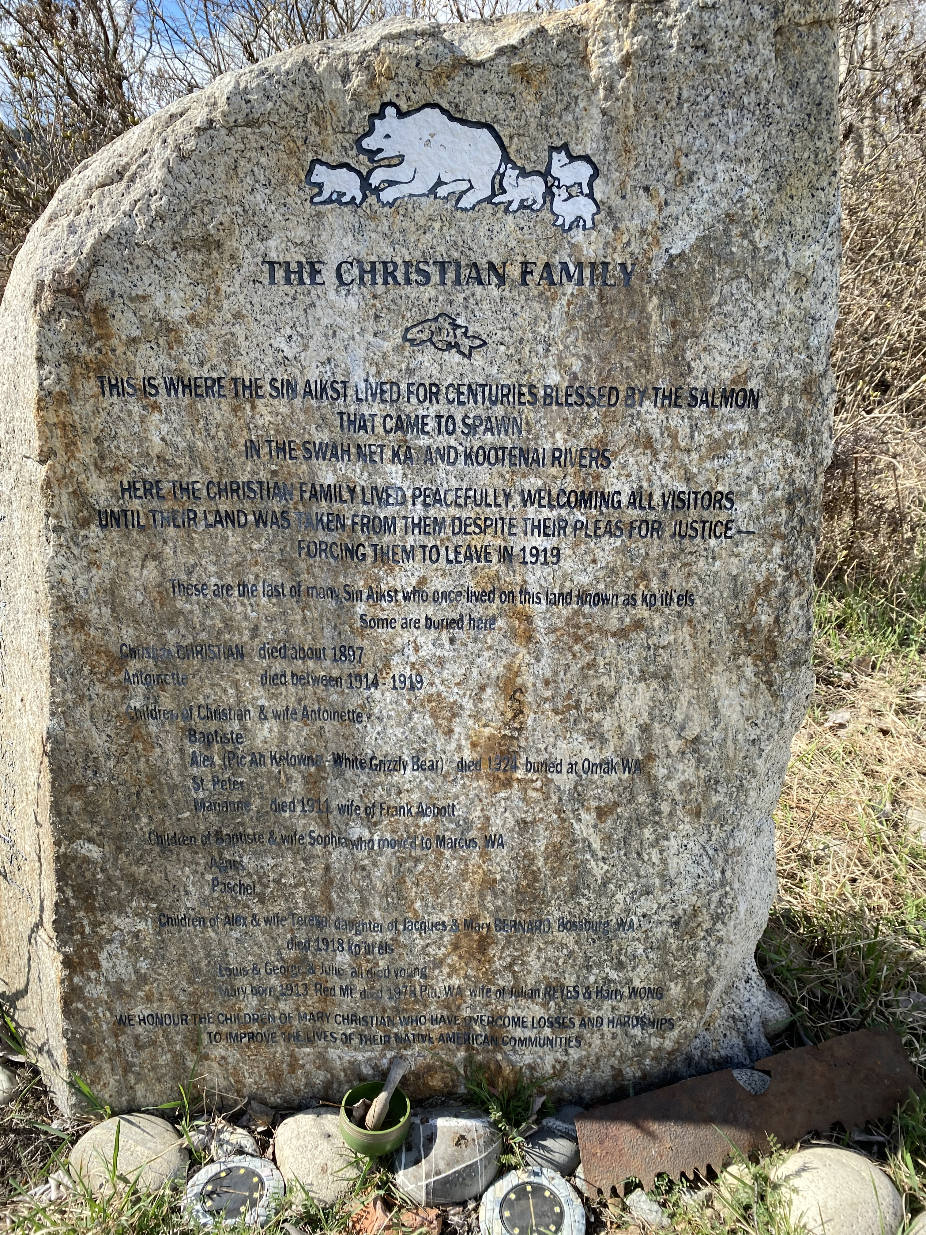
Reconciliation Stone
“On the early afternoon of 2 October 2009, some fifty to sixty people gathered for the unveiling of the memorial stone and also to witness one other historic moment – John Verigin’s public apology to Lawney Reyes and his family for any harm the Doukhobors had caused to the Sinixt people”(Wilkinson & Duff, 2012, p. 54).
Notes:
After some ‘digging’ I found an article that offer insight about the monument and the Christian family.
The article reads,
“On the early afternoon of 2 October 2009, some fifty to sixty people gathered for the unveiling of the memorial stone and also to witness one other historic moment – John Verigin’s public apology to Lawney Reyes and his family for any harm the Doukhobors had caused to the Sinixt people”(Wilkinson & Duff, 2012, p. 54).
THE CHRISTIAN FAMILY
THIS IS WHERE THE SIN AIKST LIVED FOR CENTURIES BLESSED BY THE SALMON THAT CAME TO SPAWN IN THE SWAH NET KA AND KOOTENAI RIVERS HERE THE CHRISTIAN FAMILY LIVED PEACEFULLY, WELCOMING ALL VISITORS, UNTIL THEIR LAND WAS TAKEN FROM THEM DESPITE THEIR PLEAS FOR JUSTICEFORCING THEM TO LEAVE IN 1919
These are the last of many Sin Aikst who once lived on this land known as kp’itl’els. Some are buried here
Christian CHRISTIAN died about 1897 Antoinette died between 1914 – 1919
Children of Christian and & wife Antoinette
Baptiste Alex (Pic Ah Kelowna - White Grizzly Bear) died 1924 buried at Omak WA St. Peter Marianne died 1911 wife of Frank Abbott
Children of Baptiste & wife Sophia who moved to Marcus, WA Agnes Paschel
Children of Alex & wife Teresa, daughter of Jacques & Mary BERNARD, Bossburg, WA
died 1918 kp’itl’els Louis & George & Julie all died young Mary born 1913 Red Mt. died 1978 Pia, WA wife of Julian REYES & Harry WONG
WE HONOUR THE CHILDREN OF MARY CHRISTIAN WHO HAVE OVERCOME LOSSES AND HARDSHIPS TO IMPROVE THE LIVES OF THEIR NATIVE AMERICAN COMMUNITIES.

Slide 17
Notes:
The deep erasures of these Peoples, including their cultural knowledges, language and stories has resulted in tensions with and in between multiple Peoples who all lay claim to this place.

Slide 18
Notes:
In response to this and other events (restricting access) Local anthropologist and Sinixt activist, Lori Barkley writes, “laying a reconciliation stone at kpiƛ̓ls (Brilliant) clearly hasn’t led to reconciliation with the Sinixt…[u]ltimately, there can be no reconciliation without truth. And the truth is not only that the Sinixt exist, but that the extinction order was an act of genocide” (2020 as cited in the Castlegar Source, 2021, March 16).

Slide 19
The Questions I continue to think with…
How do I share the stories of others respectfully? ‘Canada’ as a colonizing machine has dismantled, destroyed, devastated many and much. With a heavy hand, it has severed People from their lands, livelihoods and homes.
What is my responsibility as an individual and a ‘becoming academic/scholar’ in reconciliation and repatriation for these past lives/stories/histories?
‘and I also wonder about what it means to take a photo, or capture an image?
Resources for Sharing
https://sinixt.org/history
https://keepingthesinixtway.ca/
https://www.bloodoflifecollective.org/?fbclid=IwAR3QFVNcw8VqYbwP5dIJBjOiVlqqpuiPFkiTw1_hy4DQzDUmwnkMVrx119s
Doukhobors
Headwaters: Doukhobor Lore

Slide 20
References
Autonomous Sinixt Sinixt Smum Iem (2022). The Autonomous Sinixt. https://sinixt.org/
Blommaert, J. & Maly, I. (2016). Ethnographic linguistic landscape analysis and social change: A case study. In Arnaut, K., Blommaert, J., Rampton, B. and Spotti, M. Language and Superdiversity (pp. 197-217). New York: Routledge.
Castlegar Source (2021, March 16). Prohibition of motorized vehicles at Brilliant Flats only a start at reconciliation for so-called 'extinct' Sinixt. http://castlegarsource.com/news/prohibition-motorized-vehicles-brilliant-flats-only-start-reconciliation-so-called-extinct
Ministry of British Columbia (2022). Columbia River Treaty: History. https://engage.gov.bc.ca/columbiarivertreaty/history/
Nesteroff, G. (2019, May 19) Historic map reveals obscure Arrow Lakes place names: Little known arrow lakes place names. Trail Times. https://www.trailtimes.ca/community/historic-maps-reveal-obscure-arrow-lake-place-names/
Parker, B. (2006) Constructing Community Through Maps? Power and Praxis in Community Mapping , The Professional Geographer, 58:4, 470-484, DOI: 10.1111/ j.1467-9272.2006.00583.x
Popova, M. (2019). The Lost Words: An Illustrated Dictionary of Poetic Spells Reclaiming the Language of Nature. The Marginalian. https://www.themarginalian.org/2019/06/17/the-lost-words-macfarlane-morris/
Rozinkin, W. Brilliant History: Fading into Obscurity. Retrieved May 29, 2022 from https://doukhobor.org/brilliant-history-fading-into-obscurity/
Szeto, Winston (2021, March 17). B.C. restricts access to Kootenay recreation site damaged by mud bogging vehicles. CBC News. https://www.cbc.ca/news/canada/british-columbia/brilliant-flats-province-access-restriction-1.5953801
Wilkinson, M., & Sutherland, D. (2012) “From Our Side We Will Be Good Neighbour[s] to Them”: Doukhobor-Sinixt Relations at the Confluence of the Kootenay and Columbia Rivers in the Early Twentieth Century. BC Studies, (174), pp. 33-59

